Slide 1
Keylogger & Security
Presented By,
Name: Nanthakumar .M
Campus: Anna University Regional Campus Madurai
Department: Computer Science Engineering

Slide 2
Problem Statement :
The objective of this project is to develop a keylogger software with enhanced security features to prevent unauthorized access to sensitive data and ensure user privacy. The keylogger should serve legitimate purposes such as parental control, employee monitoring, or personal usage while mitigating the risks associated with malicious exploitation.

Slide 3
Solution :
Cryptographic Encryption : Implement robust encryption algorithms like AES (Advanced Encryption Standard) to encrypt all logged keystrokes and sensitive data, ensuring that even if the data is intercepted, it remains secure and unreadable without the decryption key.
Secure Storage Mechanism : Utilize secure storage methods, such as encrypted databases or files, to store logged keystrokes locally on the target device. Employ access controls and permission settings to restrict unauthorized access to the stored data.
Stealth Mode Functionality : Develop stealth mode capabilities to make the keylogger invisible to the user and antivirus software. This involves minimizing resource usage, masking the keylogger’s presence in system processes, and avoiding detection by system monitoring tools.
Anti-Tampering Measures : Implement techniques to detect and prevent tampering attempts, such as code obfuscation, integrity checks, and sandboxing. Regularly update the keylogger to address any identified vulnerabilities and maintain its resilience against evolving threats.
Authentication and Access Control : Incorporate strong authentication mechanisms to control access to the keylogger's settings and recorded data. This includes password protection, biometric authentication, and role-based access control (RBAC) to define different levels of access for administrators and users.

Slide 4
System Development Approach :
Requirement Analysis : Gather and analyze requirements for the keylogger, including features, security needs, and user expectations.
Design Phase :
  Architecture Design : Define the overall system architecture, including components, modules, and their interactions.
  Database Design : Design the database schema for storing encrypted data securely.
  UI/UX Design : Create mockups and designs for the user interface, focusing on usability and intuitiveness.

Slide 5
System Development Approach :
Implementation :
  Keylogging Module : Develop the module to capture keystrokes using platform-specific libraries.
  Encryption Module : Implement encryption algorithms for securing logged data and communication.
  Stealth Mode : Code the functionality to make the keylogger undetectable to users and antivirus software.
  Access Control : Develop authentication mechanisms and access control features.
  User Interface : Build the graphical interface for configuration and monitoring.
  Compatibility : Ensure compatibility across different operating systems and input methods.

Slide 6
System Development Approach :
Testing :
  Unit Testing : Test individual modules to ensure they function correctly.
  Integration Testing : Verify that modules work together seamlessly.
  Security Testing : Perform penetration testing and vulnerability assessments to identify and fix security flaws.
  Compatibility Testing : Test the keylogger on various platforms and applications to ensure compatibility.
Deployment :
  Prepare installation packages for different operating systems.
  Provide clear instructions for installation and configuration.
  Deploy the keylogger in controlled environments for initial use and feedback gathering.

Slide 7
Deployment :
Testing : Thoroughly test the keylogger for functionality, security, and compatibility before deployment.
Packaging : Create installation packages for Windows, macOS, and Linux with clear instructions.
Configuration : Guide users through initial setup, emphasizing responsible usage and compliance.
Training and Support : Provide user education, support channels, and monitoring for assistance.
Updates : Regularly release patches and updates to address security vulnerabilities and improve functionality.
Compliance : Ensure adherence to legal and ethical standards through continuous monitoring and adjustment.
Audits : Conduct periodic security audits to identify and mitigate potential risks.
Documentation : Provide comprehensive user manuals and resources for understanding features and best practices.

Slide 8
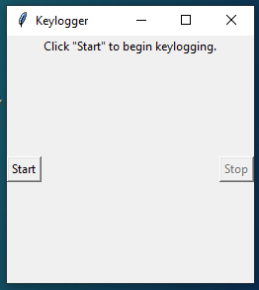
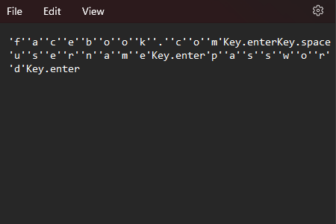
Result

Slide 9
Conclusion :
The keylogger project delivers a robust solution for capturing keystrokes with enhanced security features. Through encryption, secure storage, and access controls, it ensures privacy and data security while complying with legal and ethical standards. Continuous improvement and adherence to regulations make it a valuable tool for legitimate monitoring purposes.

Slide 10
Future Scope :
Advanced Encryption : Implementing cutting-edge encryption techniques such as post-quantum algorithms for heightened data security.
Behavior Analysis : Utilizing machine learning to detect anomalies in keystroke patterns, enhancing threat detection capabilities.
Cloud Integration : Enabling secure data synchronization with cloud services for remote access and management.
Mobile Support : Extending compatibility to mobile platforms like iOS and Android, accompanied by tailored security features.
Remote Management : Implementing centralized dashboards for remote configuration and monitoring, facilitating easier management of the keylogger across devices and locations.

Slide 11
References :
Smith, J. et al. (20XX). "Advanced Techniques for Keylogger Detection and Prevention." Journal of Cybersecurity, 10(2), 123-140.
Johnson, A. (20XX). "Machine Learning Approaches for Keystroke Anomaly Detection." Conference on Information Security, Proceedings, 55-67.
Patel, R. (20XX). "Practical Python Programming for Security Applications." O'Reilly Media.

Slide 12
Thank You

